Slide 1
The CSS Box Model

Slide 2
CSS Box Model
Border
Margin
Content: text, images, video, etc.
Border: A line around the element, still inside the element
Padding: Invisible space around the content, inside of the element
Margin: Space outside of the element, between elements
Padding
CONTENT
width
height
Fill Area : Area that gets filled with background color or background image

Slide 3
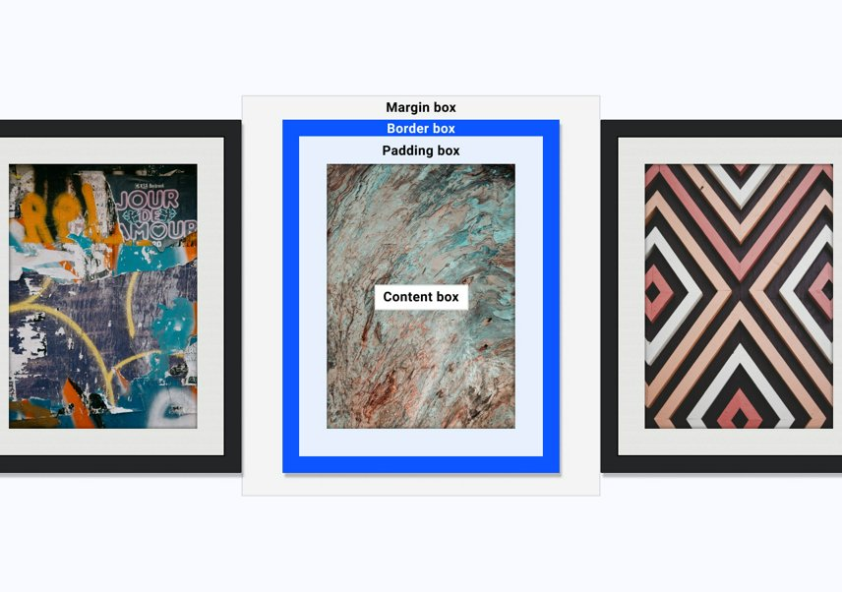
Image from web.dev/learn/css/box-model

Slide 4
Element Dimension Calculation
Final element width:
left border + left padding +
content width +
right padding + right border
Final element height:
top border + top padding +
content height +
bottom padding + bottom border
Note: Margins are not part of the element’s dimension
We can specify these values using CSS.
This is the default behavior but we can change it
Margin
Padding
CONTENT
Final element height
Final element width

